Slide 1


Celebrating Diversity and Inclusion
-
Black History, Workplace Challenges and Change
Bim Adeniran
Notes:
Hi Everyone,
It’s a pleasure to be with you today. My name is Abimbola, you can call me Bim and I'm excited to present what I have titled …

Slide 2

Agenda
A bit about me
Celebrating Black History
Black History trivia
Overcoming challenges
How we can all help
Notes:
Here’s the agenda for this presentation, I’ll start with …
*Black History Trivia* - please get your phones ready to participate with a chance to win a photo with me and lovely prize from myself as well

Slide 3
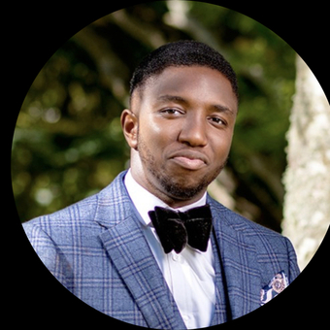
Abimbola
Notes:
My name is Abimbola – Born Into Wealth
This is what I look like when I’m not working.. Also, on my socials!

Slide 4


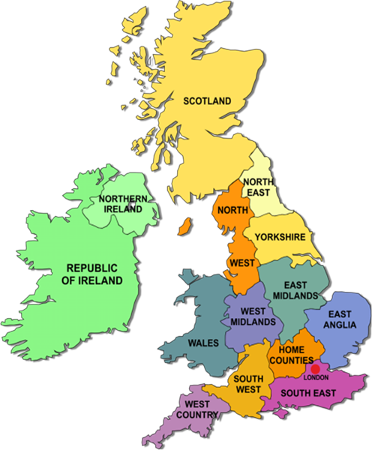


Notes:
Nigerian – West African country; World’s highest black population of over 200 million people
For football lovers I’m an Arsenal Fan. Any arsenal fans in the room? – c’mon you gonners (COYG)
Born in Southeast London, many years ago ( not too many don’t worry). My Dad worked as a Medical Doctor in London for many years and had to move back home with us as there was no headway, to start from the scratch!
Came back to the UK for my masters in Data Science at Robert University in Aberdeen, Scotland
Currently a Database Administrator with Adatis Consulting Limited in London & African living abroad
Coupled with some of the challenges of my parents, I’ve faced my own unique challenges, but more importantly achievements as an African abroad
Reflecting on these challenges, struggles, and achievements has helped me better appreciate the Black community, its history, and its significance (what it stands for)

Slide 5
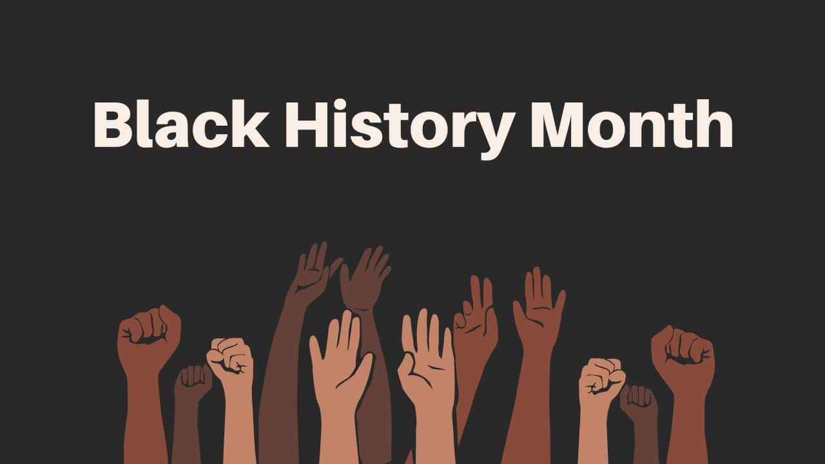

Notes:
What is Black History?
Black history refers to the collective experiences, struggles, contributions, and achievements of people of African descent, encompassing their rich cultural heritage, resilience in the face of oppression, and ongoing pursuit of diversity, equity and inclusion
Importance of Celebrating Black History (The “Why”)
Recognition and Representation: Acknowledging Black contributions ensures their stories are enshrined in history e.g. (Impactful Black Innovators and Inventors & Acknowledgment of Black Women's Contributions – Last year’s theme of Celebrating our Sisters
Education and Awareness: Celebrating Black history raises awareness and understanding of diverse experiences.
Inspiration and Empowerment; combatting Stereotypes and building Inclusive communities or Society.
Now, that you’ve heard from me on Black History and why we celebrate it, lets test your knowledge about Black History with an exciting trivia!

Slide 6
Black History Trivia
Notes:
Please use your phone to scan the onscreen QR, input a player name and click on the heart or thumbs up emoji to let us know you've joined..

Slide 7
Notes:
In what year did the UK first celebrate Black History Month?
1976
1984
1987
1960
1999

Slide 8
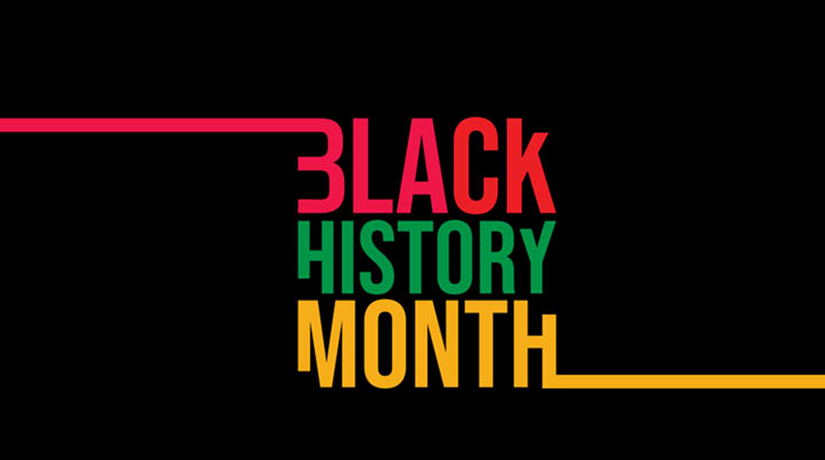
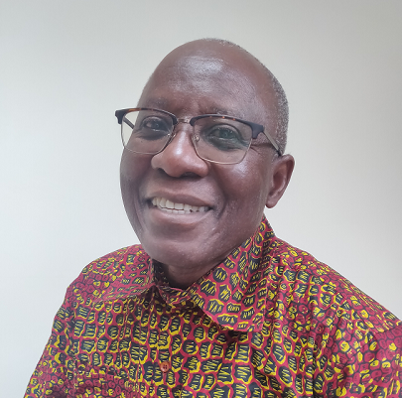
Black History Month
Notes on a page
Notes:
C - 1987
The first Black History Month in the UK took place in1987, which marked the 150th anniversary of the abolition of slavery in the Caribbeans.
This was arranged by Akyaaba Addai-Sebo, a Ghanaian refugee turned activist.

Slide 9
Notes:
What are the three colours of the main Black history or Pan-African flag?
a) Red, black, and yellow
b) Red, green, and blue
c) Red, white, and blue
d) Red, black, and green
e) Black, yellow, and green

Slide 10
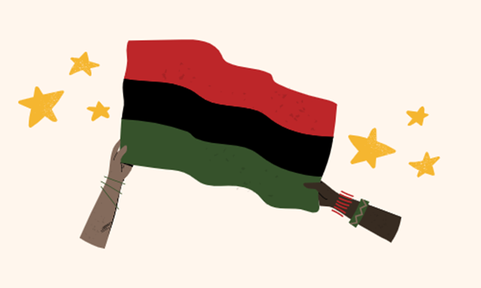

Notes:
D - Red, Black & Green
Red signifies the blood uniting people of African descent in their struggle for liberation.
Black represents black people's contributions to global history and their rich heritage.
Green symbolizes Africa's fertile land, hope, and the future.

Slide 11
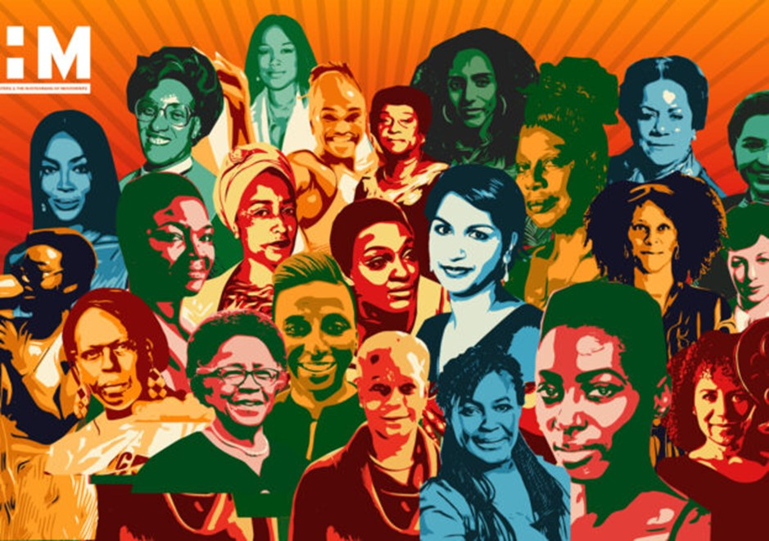
Notes:
What was last year’s (2023) UK Black History Month theme?
African American Achievements in Science and Technology
Celebrating Our Sisters
The Art and Culture of the African Diaspora
Honoring Black Women's Contributions
Black History in Education and Literature

Slide 12
Notes:
B - Celebrating Our Sisters
Last year’s theme was “Celebrating Our Sisters” which offered a significant opportunity to acknowledge and celebrate the outstanding achievements of black women by focusing on honoring the matriarchs of movements and saluting our sisters who have frequently been neglected or forgotten.

Slide 13
Notes:
Which country abolished slavery before the United States?
Italy
Australia
China
United Kingdom
Brazil

Slide 14
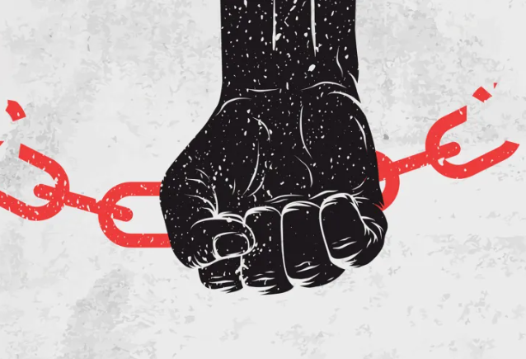
Notes:
D - United Kingdom
The UK abolished slave trade in 1807 and abolished slavery in most British colonies by the Slavery Abolition Act of 1833, freeing over 800 thousand enslaved Africans in the Caribbean and South Africa and a small number in Canada.

Slide 15

Notes:
Which Black British actor portrayed the character “Finn” in Disney’s Star Wars sequel trilogy?
a) Chiwetel Ejiofor
b) Daniel Kaluuya
c) David Oyelowo
d) John Boyega
e) Naomi Campbell

Slide 16

Notes:
D – John Adedayo Adegboyega popularly known as John Boyega.
A British-Nigerian actor born in Camberwell, gained prominence as Finn in Disney's Star Wars trilogy, breaking barriers for Black representation.
He uses his platform to advocate for diversity, speaking out against racism, and promoting teetotalism - complete abstinence from alcoholic drinks. Don’t ask to grab drinks at the pub please!

Slide 17
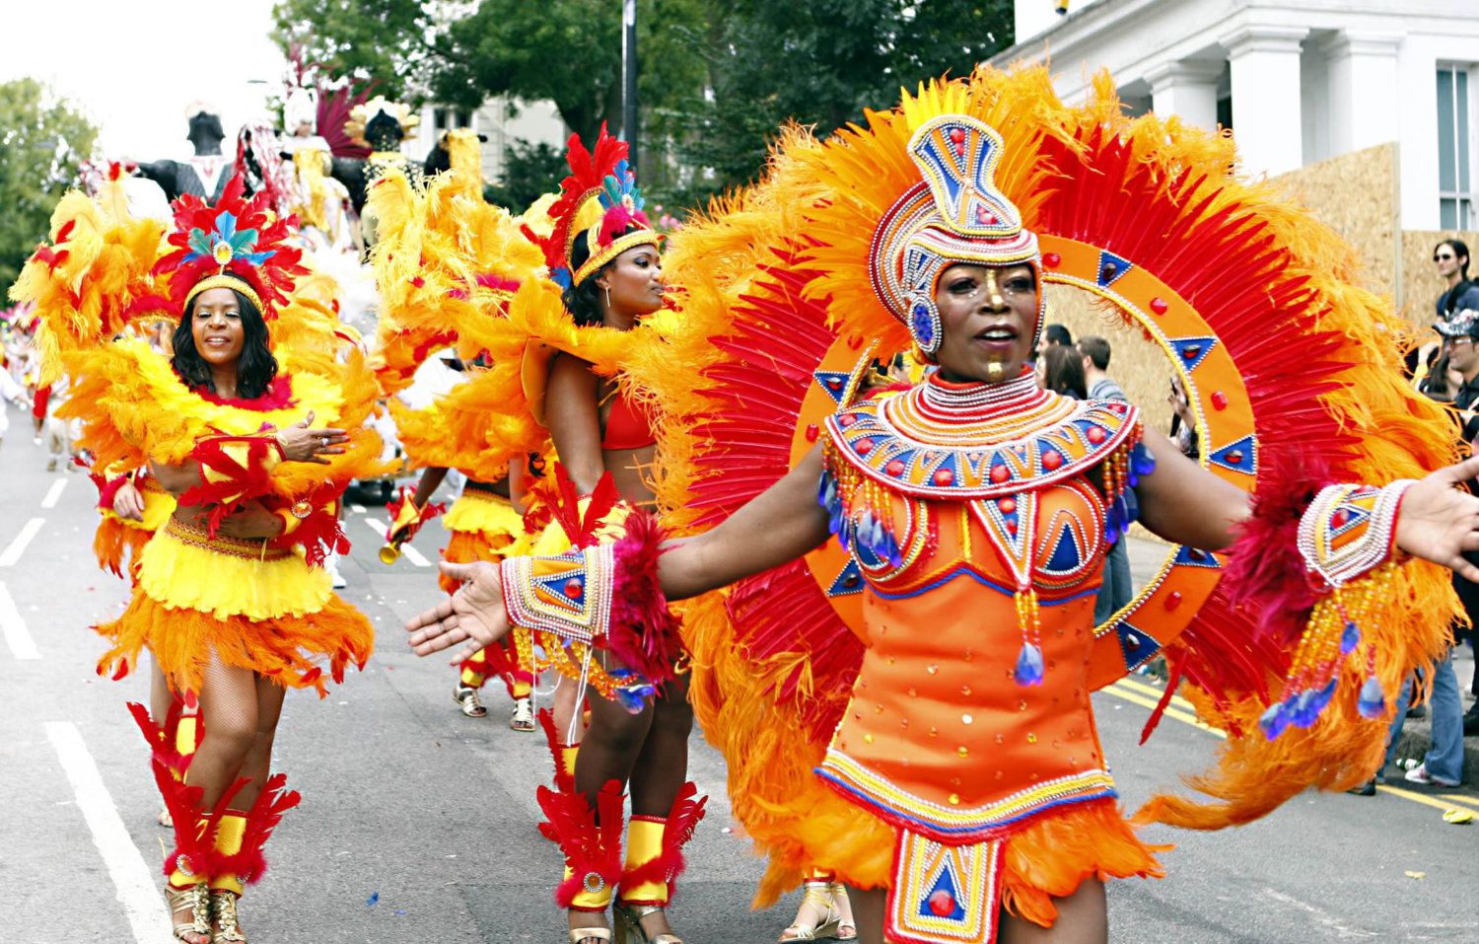
Notes:
The Notting Hill Carnival is an important event in Black British culture. When did the first event happen?
1958
1978
1960
1950
1966

Slide 18
Notes:
E - 1966
The Notting Hill Carnival, now the largest street festival in Europe, was established in 1966 as a means for Afro-Caribbean communities to honour and showcase their own cultures and traditions.
Notting Hill Carnival has become a symbol of Black Britain and its resilience to celebrate cultural pride in the face of oppression and discrimination.

Slide 19
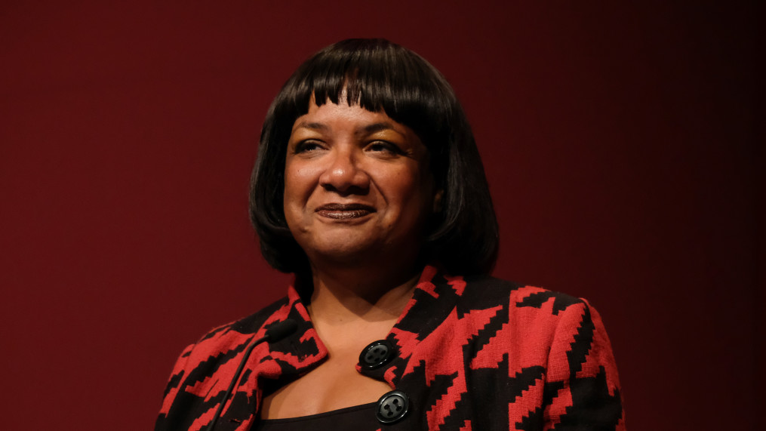
Notes:
Who was the first Black British Member of Parliament?
David Lammy
Kwasi Kwarteng
Diane Abbott
Bernie Grant
Priti Patel

Slide 20
Notes:
C - Dianne Abbott
Born in Paddington to a British-Jamaican family in 1953, She was the first Black woman elected to parliament in 1987 and the longest-serving Black MP.
Founder of the London Schools and the Black Child initiative, which aims to raise educational achievement levels amongst Black children

Slide 21
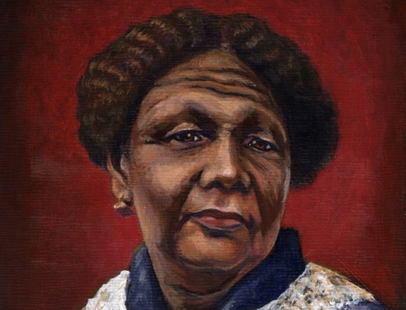
Notes:
Died in London in 1881, which Black nurse is known for saving the lives of many British soldiers in the 1856 Crimean War?
Florence Nightingale
Harriet Tubman
Sojourner Truth
Mary Seacole
Rosa Parks

Slide 22
Notes:
D - Mary Seacole
Born in Kingston, Jamaica in 1805 to a Scottish officer and Black businesswoman
A nurse who used herbal remedies to treat the sick and wounded at the military hospitals during the war.
Also a familiar figure at the transfer points for casualties from the war front, eulogized as the “Mother of the Army” alongside Florence Nightingale

Slide 23
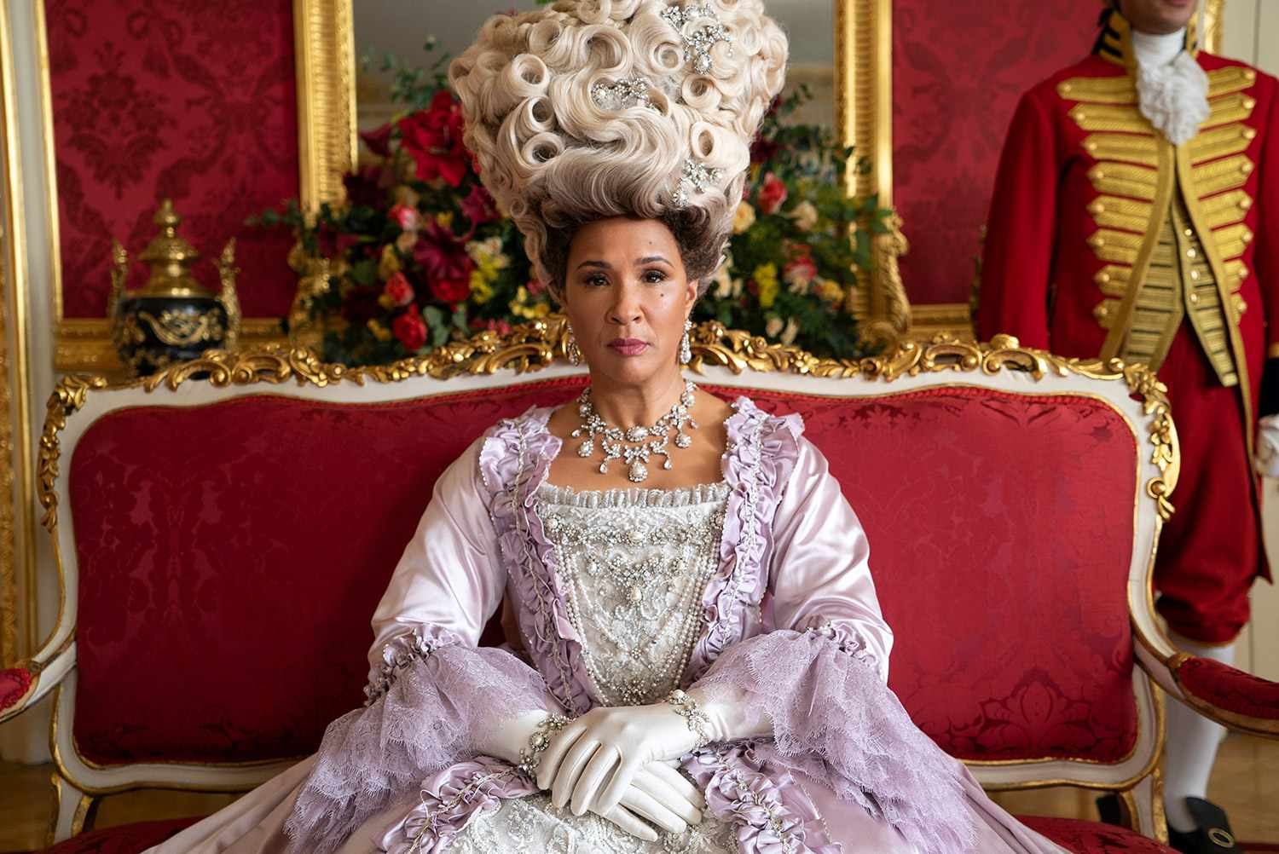
Notes:
Who was the first black queen of Britain ?
Queen Elizabeth II
Queen Victoria
Queen Charlotte
Queen Anne
Queen Mary I

Slide 24
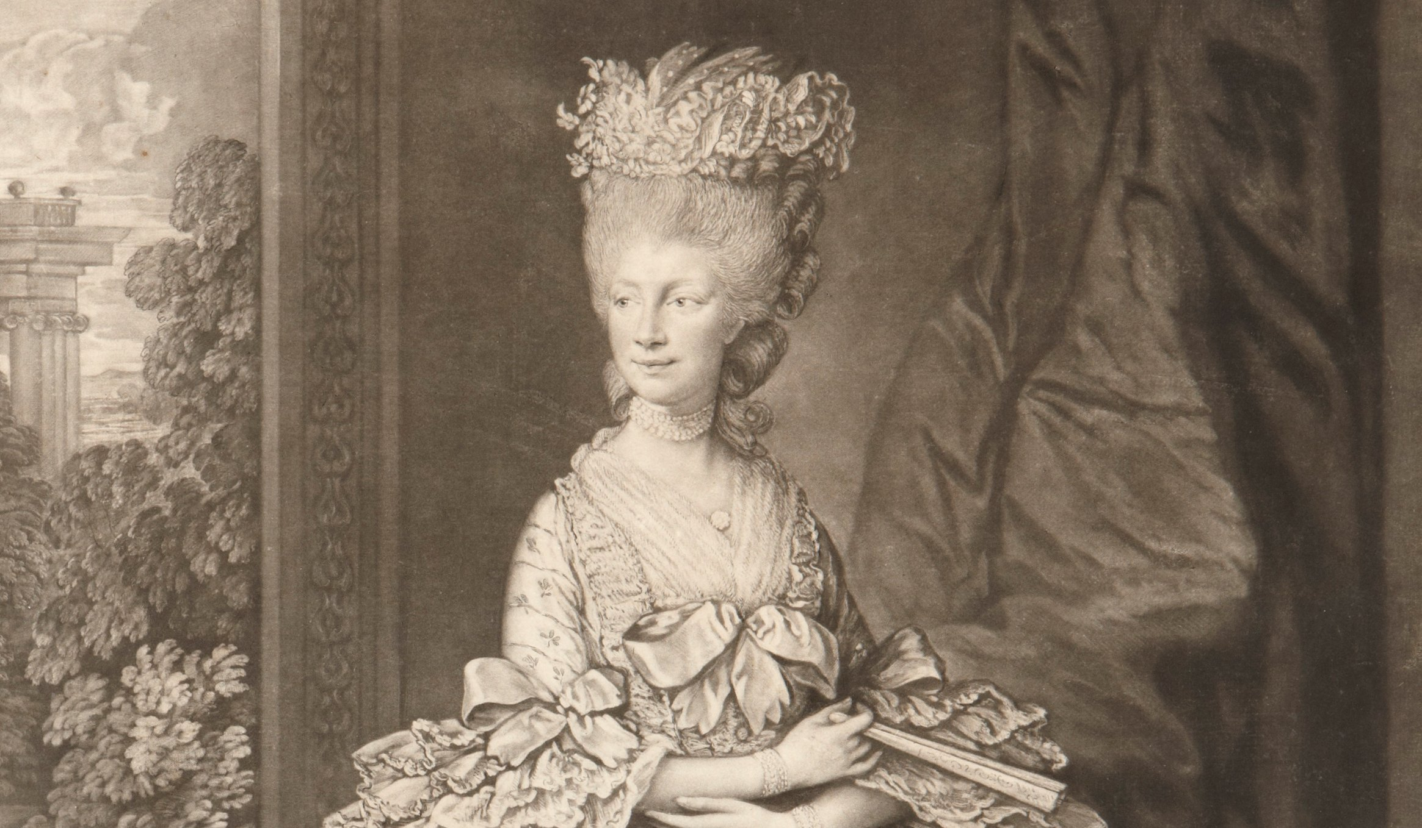
Notes:
C - Queen Charlotte
A German princess that descended from Margarita de Castro Sousa, a Black branch of the Portuguese royal family
Charlotte of Mecklenburg-Strelitz was Queen of Great Britain and Ireland as the wife of King George The Third from their marriage in 1761 until her death in 1818.
Charlotte was Britain's longest-serving queen consort, serving for 57 years and 70 days. Wow!

Slide 25
Overcoming Challenges
Notes:
Thanks very much for participating in the quiz. A round of applause!
We would see the final leaderboard at the end of presentation and the prize for the winner will be presented, please get your phone cameras ready!
We have seen from the discourse so far and the trivia, the some absolutely brilliant contributions of black people to the British society. Black excellence is also highly regarded and should be in the workplace but this is not always/has not been the case.
Let’s look at what some of the challenges are and how to overcome them

Slide 26
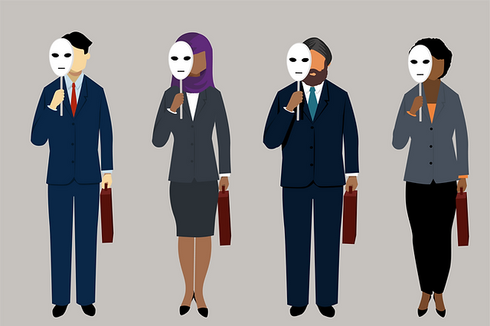
Code-Switching
Notes:
Some might ask, what is Code Switching?
One of the social biases in the workplace where black employees may feel the need to alter their behavior, way of speaking, dressing or appearance & mannerisms to fit in with their colleagues or to be taken seriously
Examples:
*A Black person may need to adjust their way of speaking (accent) to increase their odds of getting work, being heard or getting promotions (racial stereotyping). Ex: Indian Colleague
*Natural hair for women might be considered out of place in the work environment*
“……It is not for us to be them (conform); it is for them to accept us”

Slide 27



Workplace Discrimination
A black employee may be disciplined for being late to work, even though other employees are often late without being disciplined – singling out!
A black employee may be called racial slurs by their colleagues.
A black employee may be stereotyped as being lazy, unintelligent or aggressive by their colleagues.
Notes:
*WORKPLACE DISCRIMINATION*
Black employees may face discrimination in the workplace, which can lead to feelings of isolation and exclusion.
This is a serious challenge in the workplace. It can have a negative impact on the physical and mental health of black employees, and it can also damage their careers.
Examples:
A black employee may be disciplined for being late to work, even though other employees are often late without being disciplined – Singling out!
A black employee may be called racial slurs by their colleagues. – considered jokes, being trendy etc etc
A black employee may be stereotyped as being lazy, unintelligent or aggressive by their colleagues - Lazy (Tired) during Ramadam Muslim Fasting
Poses the question.. “Is there a problem with being Black?”, Martin Luther King Jr. put in succinctly in his famous quote.

Slide 28
“I have a dream that my four little children will one day live in a nation where they will not be judged by the color of their skin, but by the content of their character…”
― Martin Luther King Jr.
Notes:
“I have a dream” quote to support content on workplace discrimination

Slide 29
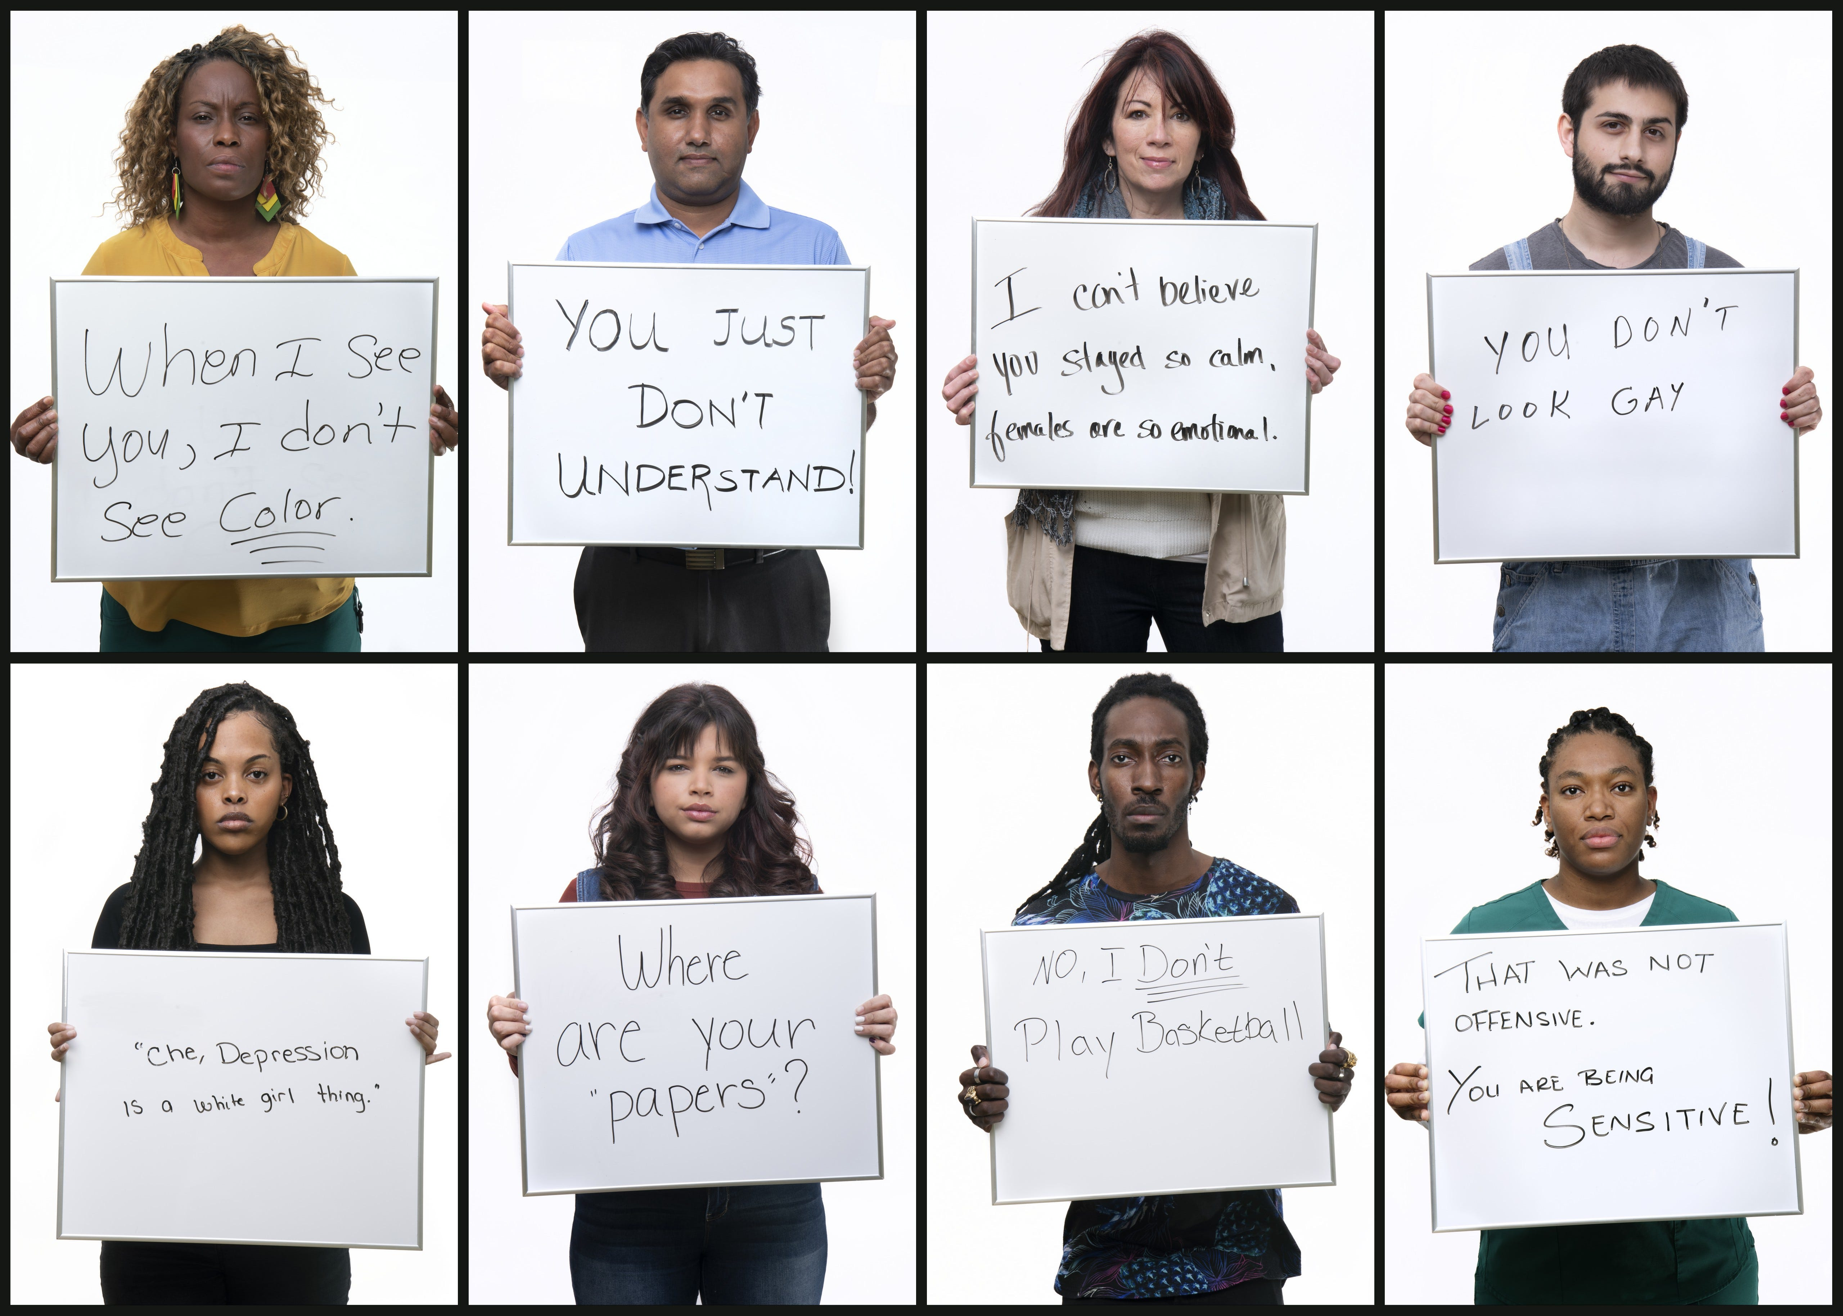
Microaggressions
Notes:
Microaggressions are subtle comments, actions and everyday behaviors that communicate negative or hostile messages towards marginalized individuals or groups, often based on their race, gender, or other characteristics.
These actions can be subtle and may not always be intended to harm, but they can have a harmful and cumulative effect on the recipients.
Let’s look at the examples in the slide...
*You just don’t understand* - negative assumptions related to intelligence
*Where are your papers?* - discriminatory but considered for jokes
*That was not offensive, you’re being sensitive* - most common, not intended for harm but can be very harmful i.e racial slurs

Slide 30
Microaggressions
“ I work in a large office, and it so happened that one day, an envelope holding a fair amount of money was missing.
The boss called me in private and requested that I confess to the crime, and he would not make it public.
I denied taking the money, but everyone didn't believe me. I felt bad and cried on the drive home.
The money was later found - it happened that the envelope was missing, he forgot he had left it in his car and thought he filed it.
He never apologised.”
Notes:
Micro aggressions can also be negative assumptions related to criminal behavior. Let’s look at that..
Speaks to the fact that: A black employee may be treated with suspicion or distrust by their colleagues or supervisors and there might be no channel of reporting such hence no repercussion for such cruel actions

Slide 31
How we can all help
Notes:
Now that have seen these three challenges of Code Switching, Workplace Ethnic and Racial Discrimination and Micro-Aggressions.
Let’s have a look at what we can do to correct such ills, making the workplace better for black employees to attain Black excellence

Slide 32

Notes:
Each and everyone of us can take steps to address these challenges; here are some actions that can be taken (call to action):
1. Educate yourself on the experiences of Black employees and the challenges they face
2. Actively listen to Black colleagues and create a safe space for them to share their experiences
3. Challenge your own biases and assumptions and be mindful of your actions
4. As organizations, offer practical strategies and best practices for promoting diversity and inclusion in the workplace, including policies, training programs, mentorship initiatives, and diversity recruitment efforts to be actual equal opportunity employers.
5. Speak up when you witness any of these. Borrowing the words of the British Transport Police: “This is a security message. If you see something that doesn’t look right, speak to staff and we’ll sort it. See it, Say it, Sorted!

Slide 33
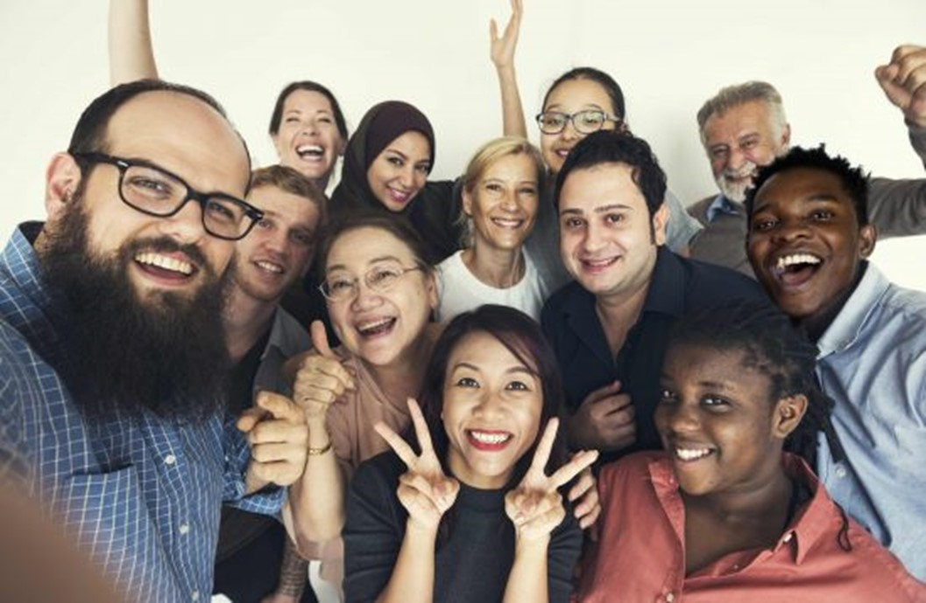
Notes:
In conclusion, this picture is indicative of a diverse and inclusive workplace where everyone is happy; you can see:
Smiling Muslim lady with the Hijab (head covering) at the back
Black people on right
Everyone else
This represents the racial diversity that should be in workplace and of course in every part of our society
There is strength in diversity, hence the reason we must start/continue to showcase our talents and celebrate our diversity.
On a final note, as everyone is in this picture and as we mean to continue, Please be kind!

Slide 34

Thank you for listening!
Do you have any questions?
Scan the QR code to connect with me on my socials
Notes:
Thank you for participating and listening…
Please scan the QR to connect with me LinkedIn.
It’s now time to see the winner of the trivia and for prize presentation.. *drumrolls*

